Slide 1
If I perish, I perish
Part One
31 July 2016
Grace Liew
Notes:
Introduction
Why did you come here today? Did you come out of duty, because of responsibilities (I’m on roster), for social or emotional needs? Hebrews 10 gives us some answers. In this chapter, it is revealed that Jesus is the sacrifice that is the one and only sacrifice that can take away our sins forever. And because of His sacrificial blood covering our sins, we can boldly enter into God’s presence. Now with that established, there are three “Let Us”. These are in vs 22-24
Let us draw near with a true heart in full assurance of faith (because our hearts and bodies are made clean)
Let us hold fast the confession of our hope without wavering (because He who promised is faithful)
Let us consider one another in order to stir up love and good works
vs 25 Not forsaking the assembling of ourselves together as others may do but exhorting one another and so much the more as you see the day approaching.
Illustration: fire place. In order to make the fire come alive, you need to turn the wood over and poke the bits that are not burning so that they will burn. That is one of the reasons why we come. To be poked to burn brighter!
Are you ready to be poked?
Overview
Today, we are going to talk about a topic that not many people like to talk about – we are going to talk about dying. But in doing so, we will talk about living. You will recognise these famous words of Esther “If I perish, I perish". How could someone like Esther have come to a place where she was willing to die for her people, a cause and her faith?
We often look to great men and women of faith and get inspired by their great acts of faith. Many were martyred for their faith in Jesus Christ (Rev 12:11). Some of us may be called to give our lives in a similar way. And others will not. Regardless, in our Christian life, we are all called to die. We are called to die a daily death surrendering our lives to God. This is actually a harder task than a one-time sacrificial act. The great men and women who paid with their lives for their faith have one thing in common, they learned to die long before they actually did.
John 12 tells us that unless a grain of wheat falls to the earth to die, it will not live again. Unless we die, we can never experience the resurrection power of Jesus working in our lives. His power is strongest in us when we willingly give ourselves over to Him in full surrender.

Slide 2
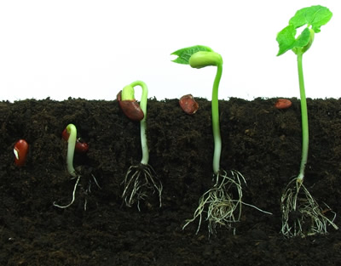
John 12:24-26 (AMP)
"I assure you and most solemnly say to you, unless a grain of wheat falls into the earth and dies, it remains alone [just one grain, never more].
But if it dies, it produces much grain and yields a harvest.

Slide 3
John 12:24-26 (AMP)
The one who loves his life
[eventually] loses it [through death],
but the one who hates his life in this world [and is concerned with pleasing God]
will keep it for life eternal.

Slide 4
John 12:24-26 (AMP)
If anyone serves Me, he must [continue to faithfully] follow Me
[without hesitation, holding steadfastly to Me, conforming to My example in living and, if need be, suffering or perhaps dying because of faith in Me];
and wherever I am [in heaven’s glory], there will My servant be also. If anyone serves Me, the Father will honour him.
Notes:
It’s the little decisions that we make that enable us to live a life that is pleasing to God and ultimately, enable us to give our lives freely to the One who gave it all for us.

Slide 5
Revelation 12:11
And they overcame him
by the blood of the Lamb and
by the word of their testimony, and
they did not love their lives to the death.

Slide 6
Overview
What does it mean to die?
The enemy to complete surrender
Living a resurrected life!
Notes:
The basis of today's message is this one central truth- when we have learned to die (to ourselves), we have truly started to live (for Jesus).
We will explore the following
What it means to die (to ourselves) and live (for Jesus)
The enemy of our soul
The resurrected life

Slide 7
What does it mean to die?
Present our bodies (Rom 12:1)
1 Cor 6:20 “For you were bought at a price; therefore glorify God in your body and in your spirit, which are God’s.”
Rom 12:1 “I beseech you therefore, brethren, by the mercies of God, that you present your bodies a living sacrifice, holy, acceptable to God, which is your reasonable service.”
Gal 2:20 “I have been crucified with Christ; it is no longer I who live, but Christ lives in me; and the life which I now live in the flesh I live by faith in the Son of God, who loved me and gave Himself for me.”
Notes:
This is what it means to die – this is how we should live (live to die)

Slide 8
What does it mean to die?
Present our members (Rom 6:13)
Rom 6:13 “And do not present your members as instruments of unrighteousness to sin, but present yourselves to God as being alive from the dead, and your members as instruments of righteousness to God.”
Notes:
This is what it means to die – this is how we should live (live to die)

Slide 9

What does it mean to die?
Present our minds (Rom 12:2)
“And do not be conformed to this world, but be transformed by the renewing of your mind, that you may prove what is that good and acceptable and perfect will of God.”
Notes:
What does it mean to die? Complete surrender
What stops us from surrendering completely?

Slide 10
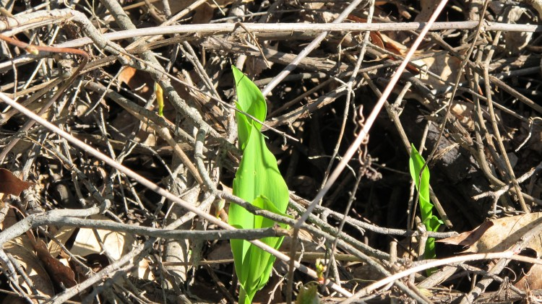
The enemy to complete surrender
Our heart attitude
Mark 4:18-19 “Now these are the ones sown among thorns; they are the ones who hear the word, and
The cares of this world,
The deceitfulness of riches, and
The desires for other things entering in choke the word, and
It becomes unfruitful.”
Notes:
Our desire for other things (things other than pleasing God) comes in and chokes the word that we have heard. So that is cannot take root and we cannot bear fruit. Remember in John 12, the point of dying is to be resurrected that we might bear much fruit.
Our heart attitude determines whether we will firstly receive the word of God, how much of it we will receive and whether we bear any fruit.

Slide 11
The enemy to complete surrender
1 John 2:15-17 (AMP)
Do not love the world [of sin that opposes God and His precepts],
nor the things that are in the world.
If anyone loves the world, the love of the Father is not in him.
For all that is in the world—
The lust and sensual craving of the flesh and
The lust and longing of the eyes and
The boastful pride of life
[pretentious confidence in one’s resources or in the stability of earthly things]—these do not come from the Father, but are from the world.

Slide 12
The enemy to complete surrender
1 John 2:15-17
The world is passing away, and with it its lusts [the shameful pursuits and ungodly longings]; but the one who does the will of God and carries out His purposes lives forever.
Notes:
The enemy to complete surrender is our attitude – attitudes of pride, self-reliance, apathy, indifference, resentment or bitterness will hinder us from being able to completely surrender, die to ourselves and therefore experience the resurrection power of Jesus.

Slide 13
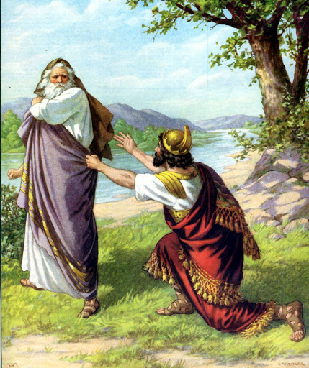
The enemy we fail to conquer, will conquer you
Saul failed to obey God’s instructions (1 Sam 15)
God’s words “I greatly regret that I have set up Saul as King, for he has turned back from following Me”
“Because you have rejected the word of the Lord, He also has rejected you…”
Saul was judged and the kingdom was given to David
Notes:
How would you feel if God said those words about you “I greatly regret”. God assessed Saul and found that he turned away. He rejected God’s word – like a man with a thorny heart, he heard God’s word but the desire for other things choked him. He allowed the Israelites to keep the choicest things so that they could bring home the spoils. He had allowed his desire for other things to enter his heart

Slide 14
Conclusion
Heb 2:1-5
Therefore we must give the more earnest heed to the things we have heard, lest we drift away.
For if the word spoken through angels proved steadfast, and every transgression and disobedience received a just reward, how shall we escape if we neglect so great a salvation, which at the first began to be spoken by the Lord,
and was confirmed to us by those who heard Him,
God also bearing witness both with signs and wonders, with various miracles, and gifts of the Holy Spirit, according to His own will?
Notes:
In your life groups, we covered a lesson on Spiritual Hunger. And in Jeremiah, our SOAP reading we have been reading about God’s loving kindness to a people that didn’t deserve it. Time after time, Israel turned their back on God. They rejected His word, They allowed other things to enter in and choke the word that they heard. God is speaking to us in this season.
James 4:8 Draw near to God and He will draw near to you. Cleanse your hands, yousinners; and purify your hearts, you double-minded.” Let’s draw near to God and not be double-minded anymore. If God is God, let’s serve Him wholeheartedly without any reservation. Let’s not turn our backs on God.

